Slide 1
Comprehensive Digital Marketing
Project Work

Slide 2
Students will be divided into 50 groups each having an individual brand name and within this would be 9 students each
Lakmé
Allen Solly
Apollo Hospitals
VLCC
Fortis healthcare institute
Fabindia
Forest Essentials
Flying Machine
Himalaya Herbals
Bata
John Players
Khadi Naturals
Louis Philippe
Liberty
Juicy Chemistry
Paragon
Peter England
Biotique
Red Tape
Britannia
Mother Dairy
Tech Mahindra
Axis Bank
Amul
Wipro
Parle Agro
Tech Mahindra
McCain
ICICI Bank
Kissan
MTR Foods
Sunfeast
HDFC Bank
HRX
Yes Bank
Cadbury
Haldiram’s
Balaji Telefilms
Digit Insurance
Life Insurance Corporation Of India
Bajaj Electricals
Havells India Ltd.
Videocon Industries Limited
Crompton Greaves Consumer Electricals
Tata Motors
Maruti Suzuki India Ltd
Mahindra & Mahindra Ltd
Hero MotoCorp Ltd
Ashok Leyland Ltd
Apollo Tyres

Slide 3
Part 1: Brand study, Competitor Analysis & Buyer’s/Audience’s Persona
Research Brand Identity: Study the brand's mission, values, vision, and unique selling propositions (USPs).
Mission/Values:
"An Ally To The Classic Indian Woman, Lakme Inspires Her To Express The Unique Beauty And Sensuality Within Enabling Her To Realize The Potency Of Her Beauty."
USP:
Lakme brings expert products and services that are borne out of true understanding of the needs of the Indian woman.

Slide 4
Part 1: Brand study, Competitor Analysis & Buyer’s/Audience’s Persona
Analyze Brand Messaging :
Professional, women Friendly and Beautiful.
Examine the brand's tagline:
Effortlessly, Fashionably, Unapologetically MÉ.
“Whenever women prioritize beauty, society diminishes them and strips them of their substance.”
“The world of Lakmé is one where women believe they do not need to apologize for their indulgence in the way they look - no guilt trips, no justifications.”

Slide 5
Part 1: Brand study, Competitor Analysis & Buyer’s/Audience’s Persona
Competitor Analysis: Select three competitors operating in the same industry or niche as the chosen brand, examine their USPs and online communication.
Competitor 1: Nykaa
USP : Offers, Discounts, Bestsellers.
Online Communication : Tips and Tricks, Brand Collaborations.
Competitor 2: Purplle
USP : All round sale, Wide variety of Products, Categorization .
Online Communication : User Generated Content, lots of Tutorials, value based content
Competitor 3: Maybelline
USP : Makeup Looks & Tips , Virtual Beauty Studio, Best Sellers .
Online Communication : Display of Products, All round Tutorials.

Slide 6
Part 1: Brand study, Competitor Analysis & Buyer’s/Audience’s Persona
Buyer's/Audience's Persona: Clearly define the target audience for the chosen brand. Consider demographics, psychographics, behaviours, and interests.
Demographic Information:
Brand Name : Lakme .
Mostly used by(Gender) : Girls and Women .
3. Age range : 18 – 50 .
4. Marital status : Married and Unmarried .
5. Occupation : Students, young professionals and Housewives .
6. Income : 15,000 - 75,000 .
7. Location : Urban and semi-urban areas .

Slide 7
Psychographic Information:
Social Class : Middle, Upper Middle class and Rich class .
Behaviours : Often buys beauty products and are interested in maintaining their beauty .
Interests : Most interested in buying women cosmetics .
Habits : Online shopping, searching about beauty tips, Look for Tutorials.
5. Lifestyle : Want to lead a healthy lifestyle .

Slide 8
Part 2: SEO & Keyword Research
SEO Audit: Do an SEO audit of the brands website
Keyword Research: Define Research Objectives, Brainstorm Seed Keywords, Utilize Keyword Research Tools (SEMrush or Moz Keyword Explorer),Analyze Competitor Keywords, Long-tail Keyword Exploration (specific, longer phrases) that align with the research objectives and have lower competition but higher conversion potential.
On page Optimization: Meta Tag optimization & content optimization
Reflect on the process of conducting keyword research and the SEO recommendations provided.
Document the challenges faced during the research and analysis phase, as well as the key insights gained from the keyword research process.

Slide 9
SEO Audit is the process of analyzing the Website’s performance in search engines. It identifies the errors and recommends suggestions which helps you rank better . Following are the simple steps which are used to do an SEO Audit 1. Search for SEO Audit Tools on Google Search Engine ,then you will get number of options like SEOptimer , SEMRUSH etc. 2.We selected SEOptimer then website will be opened enter or copy paste the URL and press Audit. Then the website will be analyzed for a while and recommends suggestions. In the same way I did SEO Audit for Brand LAKME for that there are 18 recommendations such as Optimize for Core Web Vitals , Reduce length of title tag (to between 10 and 70 characters)Shorten meta description (to between 70 and 160 characters) , Remove Duplicate H1 Tags.
SEO Audit: Do an SEO Audit of the brands Website - LAKME

Slide 10
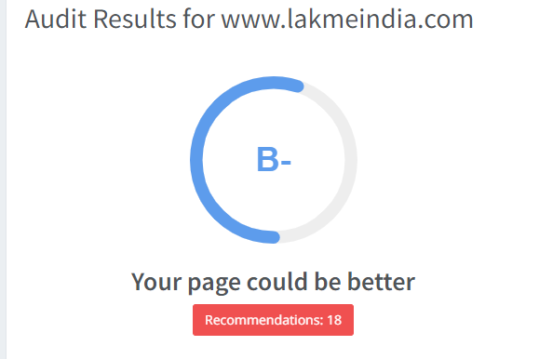

Slide 11
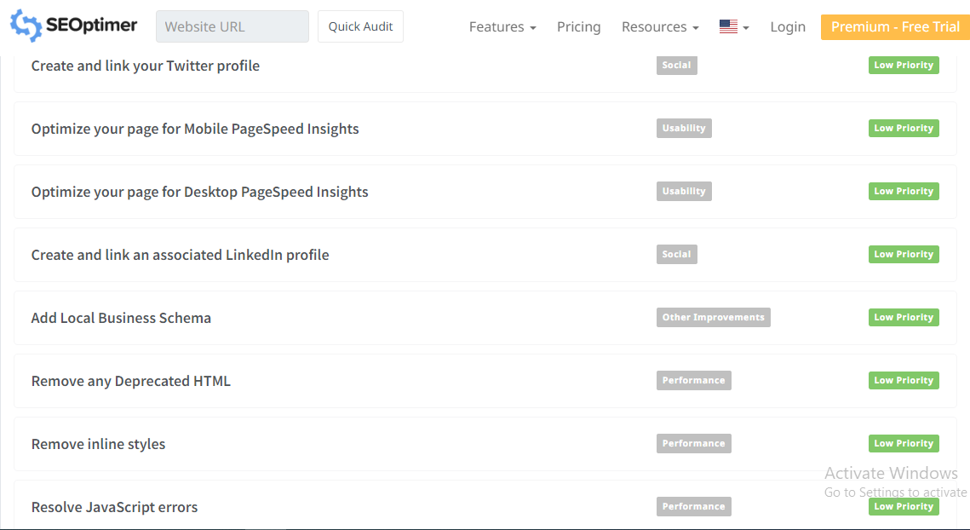

Slide 12
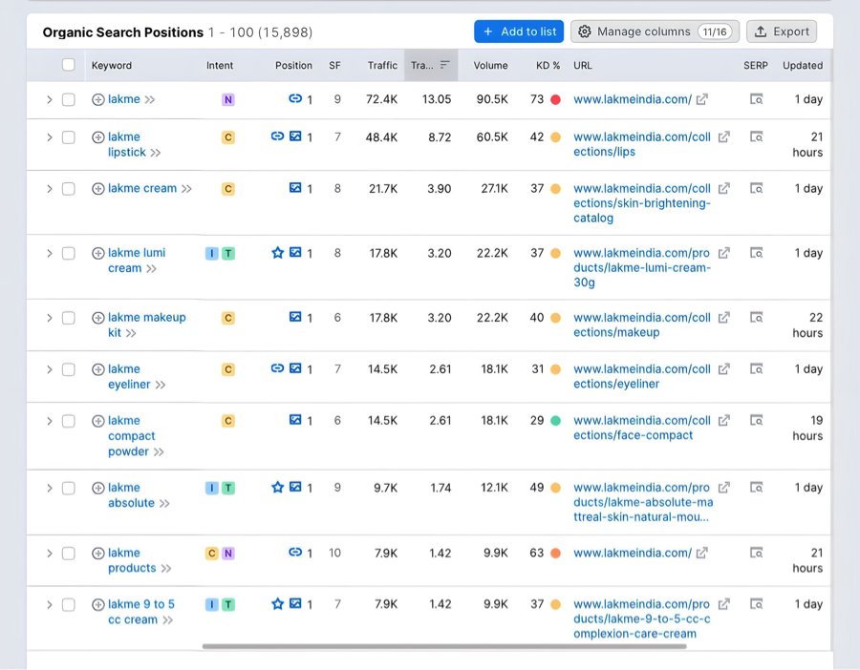
KEYWORD RESEARCH

Slide 13
Part 3: Content Ideas and Marketing Strategies
Content Idea Generation & Strategy: Create a content calendar for the remaining month of July by brainstorming content themes, exploring various formats like blog posts, videos, infographics, podcasts, and interactive quizzes, and scheduling publication dates mainly on Facebook & Instagram. And include the strategy, aim and the idea behind these posts and story
Content Calendar Example (Try creating a table for the month of July)

Slide 14
Part 3: Content Ideas and Marketing Strategies
Date | Content Theme | Content Format | Platform | Strategy & Aim
17-07-2023 | About Lakme | Video | Facebook | To market Lakme products worldwide
18-07-2023 | Lakme Lipsticks | Blog Post | Instagram | To market Lakme famous Lipsticks
19-07-2023 | Lakme Success Story | Video | Facebook | To advertise the legacy of Lakme
20-07-2023 | Lakme Skin Care | Post | Instagram | To aware people about tremendous skin care
21-07-2023 | Behind Lakme | Video | Facebook | To show the hardwork of staff in Lakme
22-07-2023 | Lakme Quiz | Interactive Quiz | Instagram | Engage audience with interactive quiz
23-07-2023 | Struggles of Lakme | Video | Facebook | To show the struggles faced by Lakme organization

Slide 15
Part 3: Content Ideas and Marketing Strategies
Reflect on the content ideas and marketing strategies process, discussing the challenges encountered and lessons learned.
1. Intense competition: The beauty and cosmetics industry is highly competitive, with numerous brands for the attention of consumers. Lakme faces stiff competition from both domestic and international beauty brands like NYKAA , PURPLLE, MAC, SEPHORA etc. making it crucial for them to continuously innovate and stay ahead of the game. 2. Market saturation: The market might be saturated with various beauty products and brands, making it challenging for Lakmé to create a unique identity and stand out from the competition. 3. Changing consumer preferences: Consumer preferences especially in the beauty industry changes rapidly, influenced by trends, social media, and influencers. Lakme needs to keep a pulse on these trends and adapt its marketing strategies accordingly. 4. Pricing strategy: Setting the right price for products is essential. Lakme needs to strike a balance between affordability and maintaining a perception of high-quality products.

Slide 16
Part 4: Content Creation and Curation (Post creations, Designs/Video Editing, Ad Campaigns over Social Media and Email Ideation and Creation)
Post Creation:
Select Content Categories: Identify three different content formats relevant to the chosen topic or industry. Research and Brainstorm: Research trending topics, industry news, or audience interests within each category. Brainstorm ideas for social media posts that align with each category. Do note that 1 content format has to be video and additionally 3 stories/status are to be created.
Format 1 : Instagram Story
Format 2 : Instagram Post
Format 3 : Video

Slide 17
Part 4: Content Creation and Curation (Post creations, Designs/Video Editing, Ad Campaigns over Social Media and Email Ideation and Creation)
Instagram Story
Utilize the Stories feature on Instagram for three consecutive days. Share behind-the-scenes glimpses, polls, quizzes, or sneak peeks etc to encourage audience participation. Once uploaded use the story highlight feature on Instagram and save the 3 story with an appropriate name for each. Note: Once done monitor the performance of the posts and Stories using the insight tool and analyze the engagement metrics (likes, comments, shares, impressions, etc.). Based on the analysis, mention the strategies and areas for improvement.

Slide 18
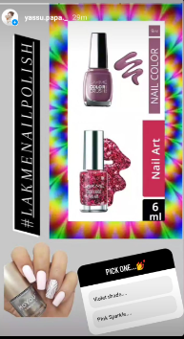
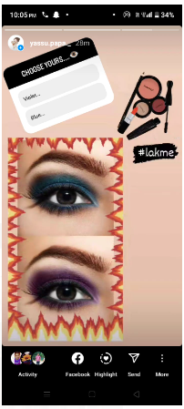
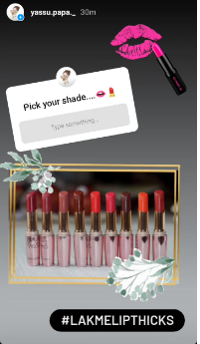
Instagram Story

Slide 19

Part 4: Content Creation and Curation (Post creations, Designs/Video Editing, Ad Campaigns over Social Media and Email Ideation and Creation)
Designs/Video Editing
Design Tools Familiarization (use Canva for creating visually appealing graphics)
Video Creation: Utilize VN or any video editor of your choice to create videos related to the chosen topic.
Right click and select Preview Option to see the video.
Created a video using VITA App.

Slide 20
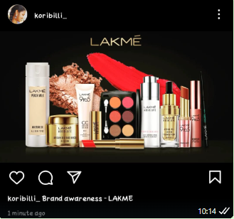
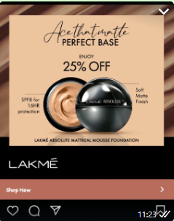
Part 4: Content Creation and Curation (Post creations, Designs/Video Editing, Ad Campaigns over Social Media and Email Ideation and Creation)
Social Media Ad Campaign
Ad Campaigns over Social Media:
Come up with 3 ad campaigns each covering one of the mentioned goals: brand awareness, driving website traffic, or generating leads
Brand Awareness
Generating Leads

Slide 21
Part 4: Content Creation and Curation (Post creations, Designs/Video Editing, Ad Campaigns over Social Media and Email Ideation and Creation)
For every campaign clearly define:
Advertising Goals: increasing brand awareness, driving website traffic, or generating leads.
Audience Targeting: Define the target audience for the ad campaigns based on demographics, interests, and behavior.
Ad Creation: Create visually appealing ad creatives, compelling ad copy and relevant call-to-action.

Slide 22
Part 4: Content Creation and Curation (Post creations, Designs/Video Editing, Ad Campaigns over Social Media and Email Ideation and Creation)
Email Ad Campaigns
Ad Campaigns for email marketing:
Come up with 2 email ad campaigns with the mentioned goals: brand awareness & generating leads

Slide 23
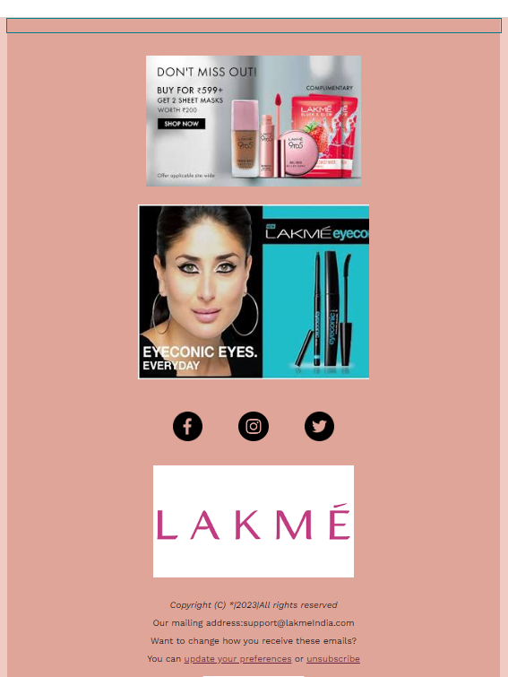
Email Ad Campaign 1 - Brand Awareness
(insert emailer image)

Slide 24
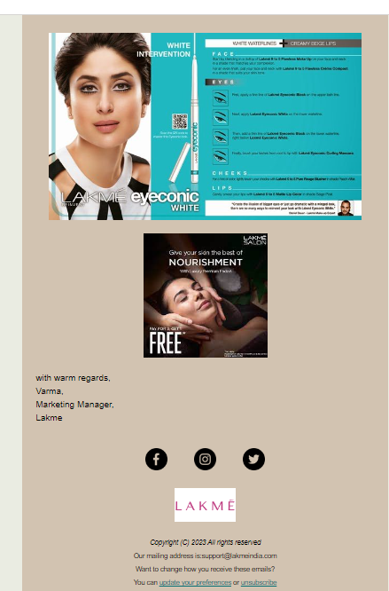
Email Ad Campaign 2 - Lead Generation
(insert emailer image)

Slide 25
Part 4: Content Creation and Curation (Post creations, Designs/Video
Editing, Ad Campaigns over Social Media and Email Ideation and Creation)
Reflect on the content creation and curation process, discussing the challenges faced and lessons learned.
First was afraid to do the content creation – story creation ,video editing, ad creation , E-mail creation later gained strength to create videos through editing apps, E-mail Ideation and creation , story creation on Instagram . Followed mentors recording classes and watched Youtube tutorials to create content on social media .
With the availability of large amount of content online it is very difficult to find relevant data.
As there includes large amount of content it involves depth research , fact-checking and editing.
Trying to create high quality content on ads, emails, videos, stories is really difficult for a beginner.
In the process of creating a PPT it is difficult to frame sentences without gramatical mistakes.
In the process of Digital Marketing Project it is difficult to adapt new concepts, new tools and using them.

